Slide 1
Object Oriented Programming
Mohamed Essam

Slide 2
Procedural Programming
Focus on processes or actions that a program takes
Programs are typically a collection of functions
Data is declared separately
Data is passed as arguments into functions
As Programs get larger they become more:
Difficult to understand
Difficult to maintain
Difficult to extend
Difficult to debug
Difficult to code

Slide 3

Coding Paradigm
https://www.freecodecamp.org/news/an-introduction-to-programming-paradigms/

Slide 4
Object Oriented
Programming
Object-oriented programming (OOP) is a programming paradigm based on the concept of "objects", which can contain data and code: data in the form of fields (often known as attributes or properties), and code, in the form of procedures (often known as methods).
Encapsulation
Objects contain data and operations that work on that data
Abstract Data Type ( ADT)

Slide 5
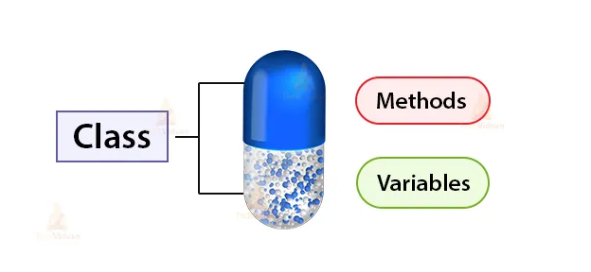
09:Object Oriented Programming

Slide 6

Object Oriented Programming
“Abstraction mean Simplify The Reality”

Slide 7

09:Object Oriented Programming
“Just all we need about the person”

Slide 8
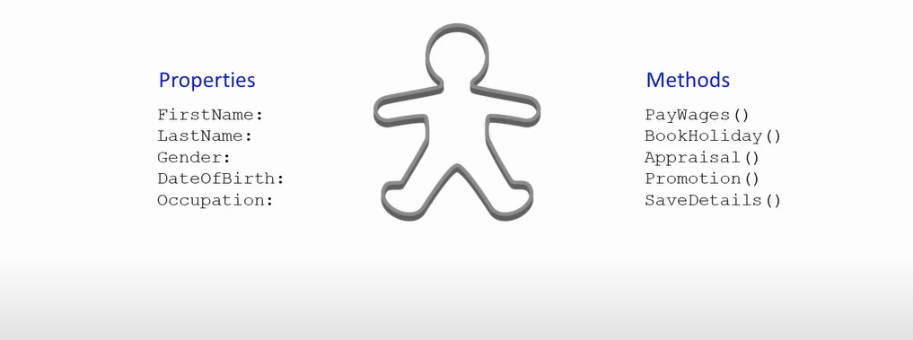
09:Object Oriented Programming
“Just all we need about the person”

Slide 9
Object Oriented
Programming
Information - Hiding
Encapsulation
Implementation - specific logic be hidden
User of class code to be interface since they don’t need to know the implementation
More abstraction
Easier to test, debug, maintain and extend

Slide 10
Object Oriented
Programming
Reusability
Easier to reuse classes in order application
Faster development
Higher quality

Slide 11

Introduction to AI with ML
09:Object Oriented Programming provide code reuse
Code reuse is the practice of using existing code for a new function or software.
This saves time, improves the features in your program, and generally makes for more cost-effective programming. Reusability is an important issue in software engineering.

Slide 12
Object Oriented
Programming
Inheritance
Can create new classes in term of existing classes
Reusability
Polymorphic classes

Slide 13



Object Oriented Programming- provide Inheritance

Slide 14

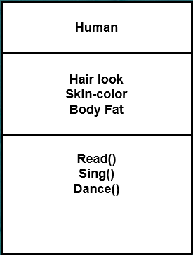
09:Object Oriented Programming
Name
Attributes
Actions

Slide 15
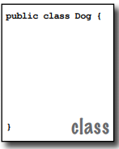

09:Object Oriented Programming
A class is an extensible program-code-template for creating objects, although a very tiny application might need just a single class. The class must go within a pair of curly braces.

Slide 16
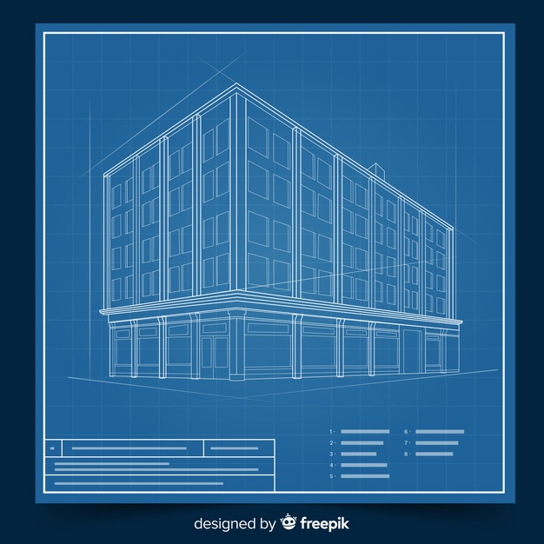

Class design like Blueprint architecture

Slide 17

Class design

Slide 18

Class design

Slide 19
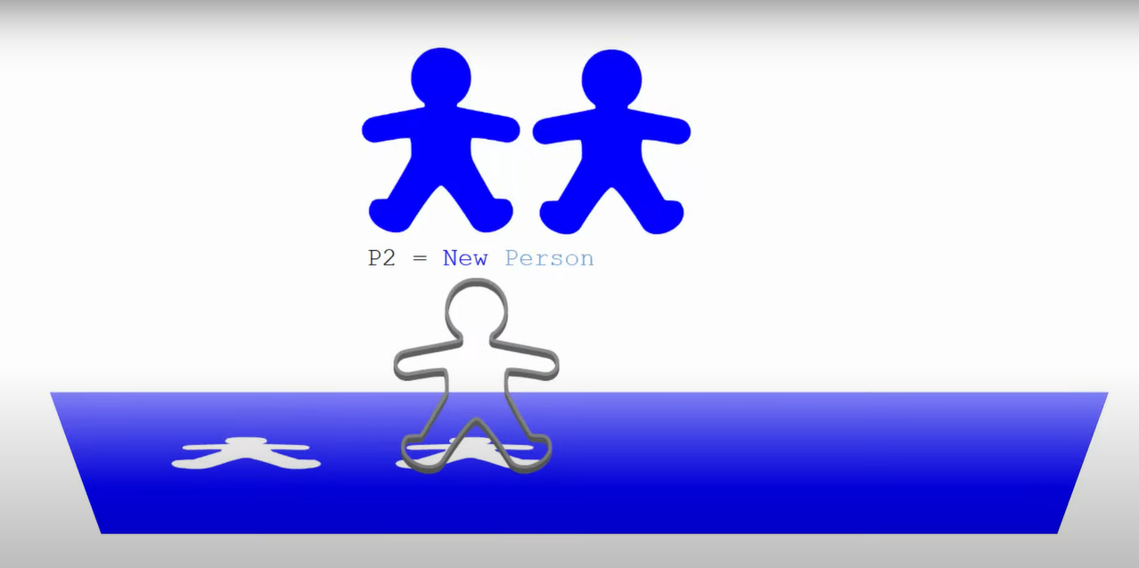
Class design

Slide 20
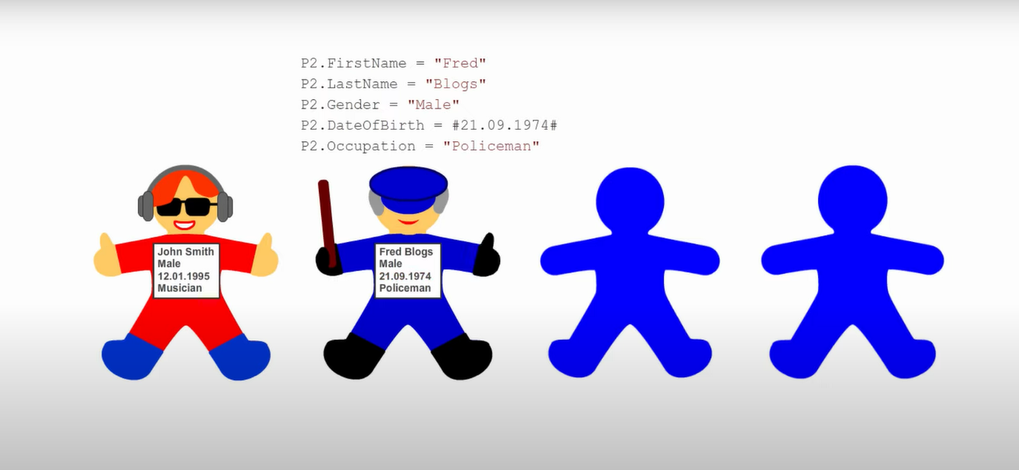
Class design

Slide 21
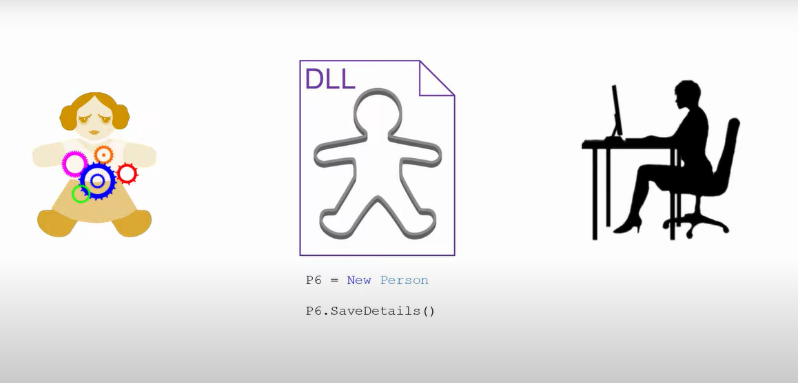
The interface of the class(Abstraction)
All you need to know to know how to use

Slide 22

The interface of the class(Abstraction)
All you need to know to know how to use

Slide 23

09:Object Oriented Programming
Class
Car
Mercedes
Nissan
Honda
Jeep

Slide 24
09:Object Oriented Programming provide code reuse
Code reuse is the practice of using existing code for a new function or software.
This saves time, improves the features in your program, and generally makes for more cost-effective programming. Reusability is an important issue in software engineering.

Slide 25
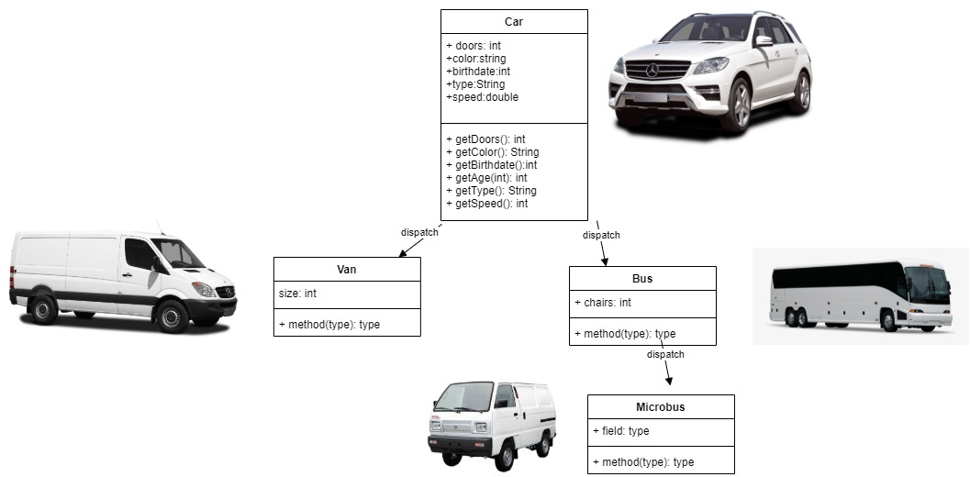
Create Class using unified modeling language UML

Slide 26
Accessing Class
We can access
Class attributes
Class methods
Some class members will not be accessible (more on that later)
We need an object to access instance variables

Slide 27
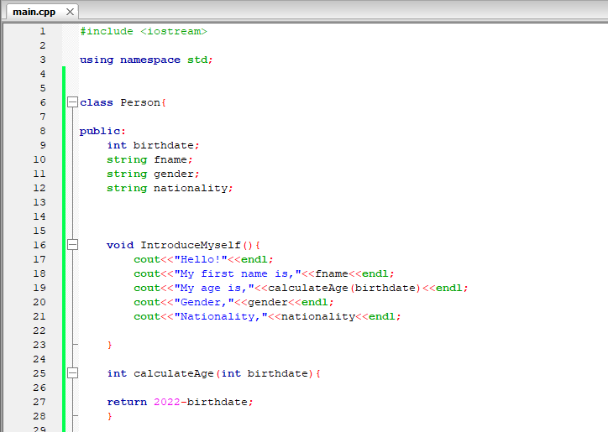
Class Access Modifier
public , private and protected
public
Accessible everywhere
private
Accessible only by members or friends of the class
protected
Used with inheritance - we’ll talk about it in the next section

Slide 28
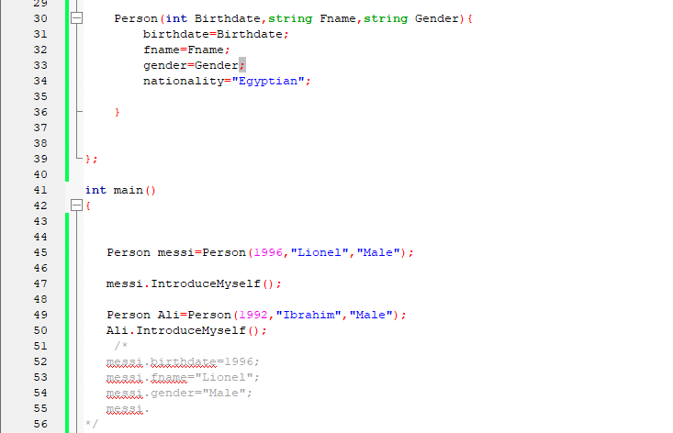
Class Access Modifier
public , private and protected
public
Accessible everywhere
private
Accessible only by members or friends of the class
protected
Used with inheritance - we’ll talk about it in the next section

Slide 29
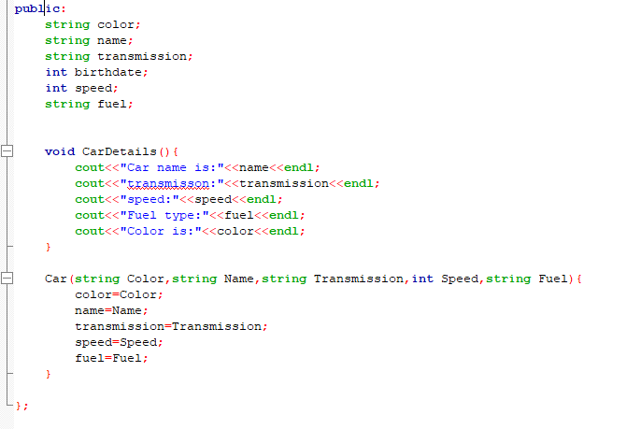
Class Access Modifier
public , private and protected
public
Accessible everywhere
private
Accessible only by members or friends of the class
protected
Used with inheritance - we’ll talk about it in the next section

Slide 30
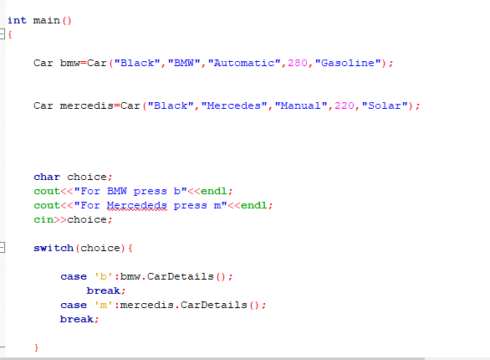
Class Access Modifier
public , private and protected
public
Accessible everywhere
private
Accessible only by members or friends of the class
protected
Used with inheritance - we’ll talk about it in the next section

Slide 31
Class Access Modifier
public , private and protected
public
Accessible everywhere
private
Accessible only by members or friends of the class
protected
Used with inheritance - we’ll talk about it in the next section

Slide 32

What are setters and getters?
Getters and setters are used to protect your data, particularly when creating classes. For each instance variable, a getter method returns its value while a setter method sets or updates its value. Given this, getters and setters are also known as accessors and mutators, respectively.

Slide 33
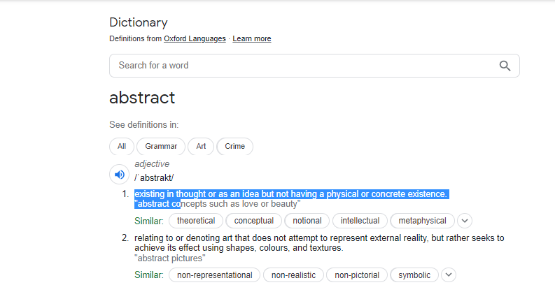
What is a abstract?
By definition, an abstract class in C++ is a class that has at least one pure virtual function (i.e., a function that has no definition).

Slide 34
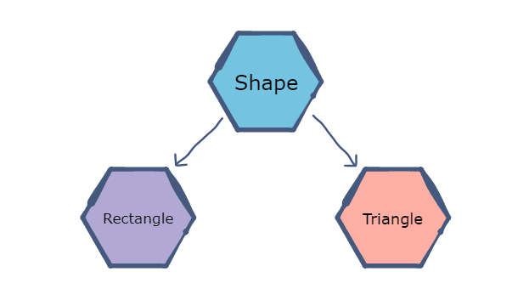
What is a C++ abstract class?
By definition, an abstract class in C++ is a class that has at least one pure virtual function (i.e., a function that has no definition).

Slide 35
What is a C++ abstract class?
Abstract classes are essential to providing an abstraction to the code to make it reusable and extendable.
For example, a Vehicle parent class with Truck and Motorbike inheriting from it is an abstraction that easily allows more vehicles to be added. However, even though all vehicles have wheels, not all vehicles have the same number of wheels – this is where a pure virtual function is needed.

Slide 36
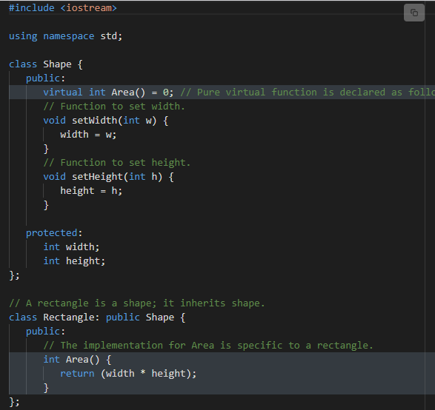
What is a C++ abstract class?

Slide 37
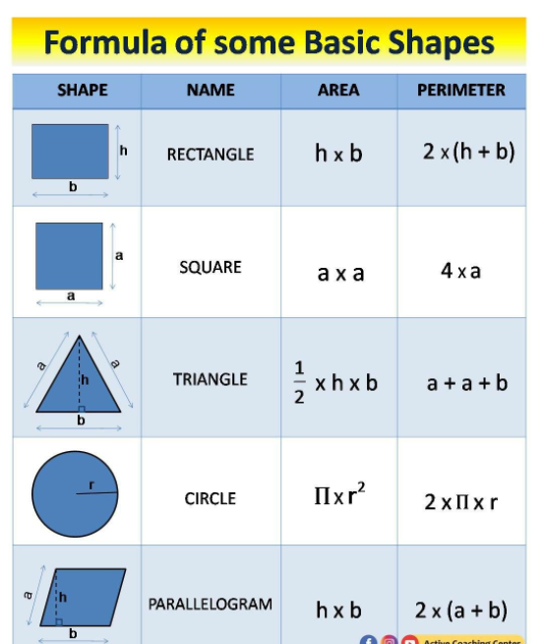
What is a C++ abstract class?

Slide 38
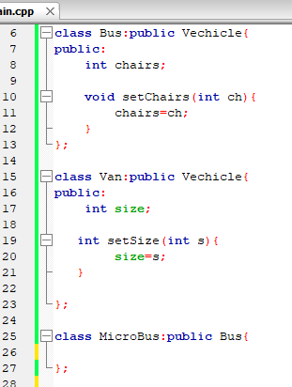
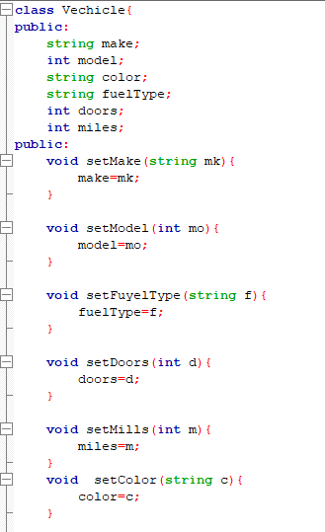
Inhertance

Slide 39
Thanks

